Slide 1
IoT and Semantic Interoperability A report on recent progress with web of things standards, thing description, metadata bridging, and semantic discovery in IoT
Michael McCool
Intel: Principal Engineer
W3C: Web of Things WG Co-Chair
IETF100 T2TRG Talk: November 14, 2017

Slide 2
Agenda
What is semantic interoperability?
Why do we care, in the context of IoT?
How we implement it?
Now some recent activity…
Web of Things – Thing description and semantic discovery
iotschema.org – IoT ontology
OCF metadata bridge – dynamically translate OCF metadata to TDs
AVS integration (work in progress) – translate AVS intents to IoT ontology
Fog service integration (planned) – services as discoverable “things”

Slide 3
Evolution of the IoT towards “ambient” computing…
Cloud Supported IoT Devices
Locally Networked IoT Devices
Fog Supported IoT Devices
Ambient Service Ecosystem
IoT devices connect to mostly independent cloud services
IoT devices connect to others in isolated ecosystems
IoT devices can discover and connect to local “fog services” that facilitate interop.
Services composed from dynamically discovered devices and services
Notes:
A specific example would help… but how to do it without a lot of clutter? Another slide? Maybe take out the definitions in the light blue boxes (titles are good enough…)

Slide 4
What?
What is interoperability?

Slide 5
Interoperability: What is it?
Two entities can be interfaced “directly”
Web browser can access a web server and render content from it
Despite my never having visited that site before
I can plug my laptop into the wall to charge
I can replace lightbulbs in my apartment
I can buy bolts and nuts and expect them to work together
For the IoT:
I want to use devices (and data from those devices) from different manufacturers in the same system

Slide 6
Levels of Interoperability
Semantic: Be able to decode the meaning of data.
Convert to a representation that has tagged elements with identifiers, properties, and relationships using elements rooted in shared contexts, vocabularies, and ontologies.
Structural: Be able to decode the organization of data.
Convert data into a set of common primitive types (numbers, characters, etc) structured with a set of organizational patterns (lists, sets, arrays, links, objects, tables, etc).
Syntactic: Be able to decode the encoding of data.
Convert data in a consistent way between a serialized (transmissible, storable) representation (eg a sequence of bytes) and an internal data structure (eg a parse tree).
Notes:
See: https://github.com/t2trg/2017-07-wishi
Semantic Interoperability — understand what the data/actions mean (Probably rooted in ontologies, vocabularies)
Structural: Know how to find certain information, understand the composition (Information Model?, Data Model?, ASN.1, XSD, ...) Two levels:
primitive -- constrained by serialization [data model]
more abstract, still structural [information model]
Syntactic: parse/generate (Serialization; pretty much domain-independent -- comes from representation framework, BER, XML serialization, EXI, JSON, CBOR...)

Slide 7
Why?
Why do we want interoperability?

Slide 8
Business Value of Interoperability
“Interoperability between IoT systems is critically important to capturing maximum value; on average, interoperability is required for 40% of potential value across IoT applications and by nearly 60% in some settings.” [+$4.1B TAM by 2025]
McKinsey & Company, The Internet of Things: Mapping the Value Beyond the Hype, 2015
$6.5 Trillion per year in 2025
Home $200B to $350B
Offices $70B to $150B
Outside – logistics and navigation $560B to $850B
Cities – public health and transportation $930B to $1.7T
Health & Fitness $200B to $350B
Factories – operations and equipment optimisation $1.2T to $3.7T
Worksites $160B to $930B
Retail $170B to $1.6T
Cities – public health and transportation $930B to $1.7T
Notes:
An additional reference (has a lot of quotes from multiple sources)
Interoperability in the Internet of Things: Interviews, Computer.org, 2016.
https://www.computer.org/web/computingnow/archive/interoperability-in-the-internet-of-things-december-2016-interviews
For example:
“… full-blown interoperability is completely indispensable for the progress of IoT ecosystems. Nowadays, customers and manufacturers have a huge number of technologies and solutions to choose from, and the risk of investing in a nonstandard option is too high because of its possible obsolescence. The absence of an open interoperability framework is one of the factors that is limiting the expansion of IoT ecosystems (and, therefore, its maximum market and technological potential).”
Although there are also some quotes that take the opposite view (although usually of the form “lack of interoperability won’t be a limiter in the short term, but will eventually be so.”)
Other references:
https://internetofbusiness.com/iot-value-comes-interoperability/
https://www.mckinsey.com/industries/semiconductors/our-insights/whats-new-with-the-internet-of-things
From automotive: https://arstechnica.com/cars/2017/10/blue-roads-and-glowing-signs-how-this-startups-tech-lets-cars-see-the-world/
…having multiple walled gardens for different makes of autonomous vehicles is highly undesirable; more cars contributing to the same platform means greater coverage of the road network, not to mention bigger sets for the machine learning algorithms that will process that data. "If a car around the next corner hits the brakes because there’s an obstruction, that information could be used to signal to the drivers behind to slow down ahead of time, resulting in smoother, more efficient journeys and a lower risk of accidents. But that can only work if all cars can speak and understand the same language," said Dietmar Rabel, Here's head of autonomous driving product management.
How many standards in a laptop?
http://ieeexplore.ieee.org/stamp/stamp.jsp?arnumber=5682128&tag=1

Slide 9
Business Value of Interoperability
“Interoperability between IoT systems is critically important to capturing maximum value; on average, interoperability is required for 40% of potential value across IoT applications and by nearly 60% in some settings.” [+$4.1B TAM by 2025]
McKinsey & Company, The Internet of Things: Mapping the Value Beyond the Hype, 2015
$11.1 trillion per year in 2025
Home $200B to $350B
Offices $70B to $150B
Outside – logistics and navigation $560B to $850B
Cities – public health and transportation $930B to $1.7T
Health & Fitness $200B to $350B
Factories – operations and equipment optimisation $1.2T to $3.7T
Worksites $160B to $930B
Retail $170B to $1.6T
Cities – public health and transportation $930B to $1.7T
Notes:
An additional reference (has a lot of quotes from multiple sources)
Interoperability in the Internet of Things: Interviews, Computer.org, 2016.
https://www.computer.org/web/computingnow/archive/interoperability-in-the-internet-of-things-december-2016-interviews
For example:
“… full-blown interoperability is completely indispensable for the progress of IoT ecosystems. Nowadays, customers and manufacturers have a huge number of technologies and solutions to choose from, and the risk of investing in a nonstandard option is too high because of its possible obsolescence. The absence of an open interoperability framework is one of the factors that is limiting the expansion of IoT ecosystems (and, therefore, its maximum market and technological potential).”
Although there are also some quotes that take the opposite view (although usually of the form “lack of interoperability won’t be a limiter in the short term, but will eventually be so.”)
Other references:
https://internetofbusiness.com/iot-value-comes-interoperability/
https://www.mckinsey.com/industries/semiconductors/our-insights/whats-new-with-the-internet-of-things
From automotive: https://arstechnica.com/cars/2017/10/blue-roads-and-glowing-signs-how-this-startups-tech-lets-cars-see-the-world/
…having multiple walled gardens for different makes of autonomous vehicles is highly undesirable; more cars contributing to the same platform means greater coverage of the road network, not to mention bigger sets for the machine learning algorithms that will process that data. "If a car around the next corner hits the brakes because there’s an obstruction, that information could be used to signal to the drivers behind to slow down ahead of time, resulting in smoother, more efficient journeys and a lower risk of accidents. But that can only work if all cars can speak and understand the same language," said Dietmar Rabel, Here's head of autonomous driving product management.
How many standards in a laptop?
http://ieeexplore.ieee.org/stamp/stamp.jsp?arnumber=5682128&tag=1

Slide 10
How?
How to achieve interoperability?

Slide 11
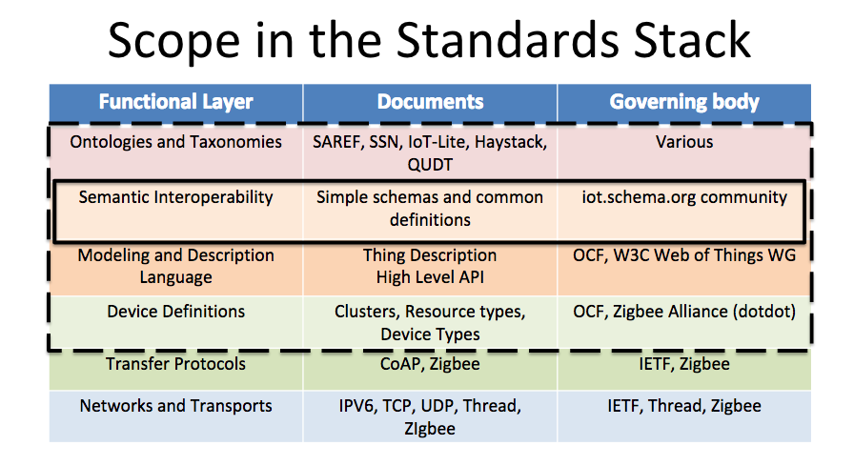
IoT Ontology
iotschema.org
Project to develop simple and common IoT ontologies for semantic interoperability
Principals: Michael Koster (Samsung/Smart Things), David Janes (IOTDB), Darko Anicic (Siemens), Dan Brickley (Google)
See: iotschema.org site, discussion doc, and meeting minutes

Slide 12
IoT Ontology: iotschema.org
schema:target
schema:EntryPoint
schema:thing
schema:PropertyValue
Capability
InteractionPattern
schema:PropertyValueSpec.
providesInteractionPattern
acceptsInputData
providesOutputData
rdfs:subclassOf
Action
schema:Property
Event
iotschema Class
Property
Reused Class

Slide 13
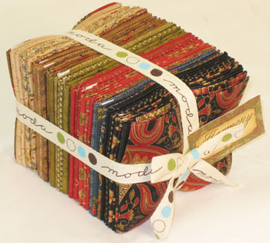
Things (IoT Services) as Capability Bundles
“Things” considered as
Bundles of Capabilities
Capabilities support specific sets of properties, actions, and events
Things (or Services) support sets of Capabilities
This is a more flexible model than just having definitions of particular Services or Things
Ideally we want a way to model novel devices, not just select them from a list
Capabilities allow us to model a novel device by selecting (and perhaps parameterizing) a set of capabilities
Bundle theory, originated by the 18th century Scottish philosopher David Hume, is the ontological theory about objecthood in which an object consists only of a collection (bundle) of properties, relations or tropes.
As opposed to substance theory…

Slide 14

Web of Things Architecture
WoT Servient
JavaScript
1. WoT Thing Description (TD) with simple interaction model
Runtime Environment
Lua
Properties
App Script 2
3. WoT Scripting API for a browser-like runtime environment
Actions
Events
App Script 1
Scripting API
Thing Description
Interaction Model
Local Hardware
Binding Templates
2. WoT Binding Templates to connect to different platforms and ecosystems
Things can be in client and/or server role: “Servient”
Server
Client
HTTP
OCF
BACnet
Expose
Consume
CoAP
OneM2M
…

Slide 15
Thing Description Example
{ "@context":["http://w3c.github.io/wot/w3c-wot-tdcontext.jsonld", "http://w3c.github.io/wot/w3c-wot-common-context.jsonld", {"iot":"http://iotschema.org/"}, {"http":"http://www.w3.org/2011/http/"}], "base":"http://example.ocfgateway.net/api/oic", "@type":["Thing","Light","iot:LightControl", // Capabilities "iot:Actuator","iot:BinarySwitch"], "name":"Intel-OCF-Smart Home LED (2relay)", "interaction":[ {"name":"Switch Status", "@type":["Property","OnOffState","iot:SwitchStatus"], // Interactions "link":[ {"href":"/a/led2relay?di=79683ab5-8df1-4b7a-b110-c1b8fe251e7d", "mediatype":"application/json", "http:methodName":"http:post", // Methods (specific to protocol binding) "rel":"setProperty"}, {"href":"/a/led2relay?di=79683ab5-8df1-4b7a-b110-c1b8fe251e7d", "mediatype":"application/json", "http:methodName":"http:get", "rel":"getProperty"} ], → Payload structure and semantics }, → Other interactions: Properties, Events, and Actions ] }
W3C WoT TD vocabulary
JSON-LD (Linked Data)
Domain-specific vocabulary

Slide 16
Thing Description Example
// Payload structure and semantics for a Property interaction
"inputData":{ "type":"object", "fields":[ {"name":"value", "value":{"@type":["iot:Toggle"], // Data "type":"boolean“} } ]}, "outputData":{ "type":"object", "fields":[ {"name":"value", "value":{"@type":["iot:Toggle"], "type":"boolean“} } ]}
JSON Schema

Slide 17
Now!
Proof of Concept Work…

Slide 18
Proof of Concept Development Goals
Understand the relationships of different technologies
Identify technology and standards gaps
Overcome specific technical obstacles and gaps
Demonstrate the business value of new technologies
Test integration patterns for multiple technologies
Advance engagements with key ecosystem players
Notes:
After the above infrastructure is in place, we still want to schedule some POCs for “development systems” based around service composition.

Slide 19
Stages
Metadata Bridging (value: increase adoption and applicability)
→ Support all existing IoT devices from multiple ecosystems
Rather than trying to bridge data peer-to-peer, bridge metadata
Supports end-to-end security since data translation can be pushed to secure endpoints
Semantic Voice Control (value: demonstrate utility, engage key ecosystem player)
Support any IoT device with adaptive semantic voice controls
Fog Integration (value: develop support for ubiquitous localized services)
Deploy using local compute resources for proxies, translators, and acceleration
Service-Oriented Development System (value: support ecosystem development)
→ Support development and deployment of code for services, not (just) devices
Notes:
After the above infrastructure is in place, we still want to schedule some POCs for “development systems” based around service composition.

Slide 20
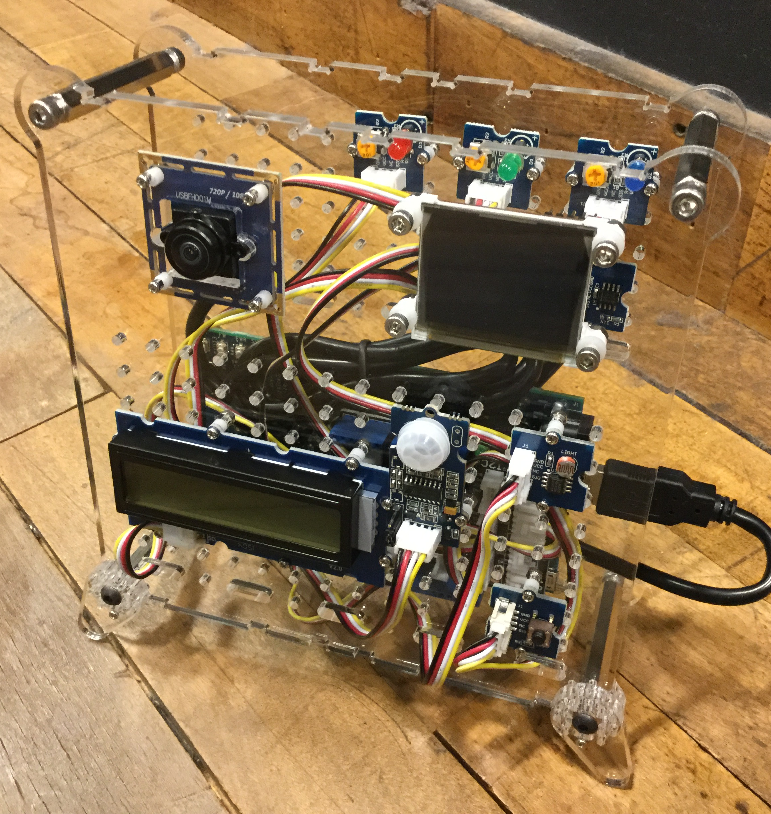
1. Metadata Bridging
Goal: Maximize number of devices accessible
Translate all metadata into common format (WoT TD)
Infer capabilities and annotate with iotschema.org vocabulary
Register all things with Thing Directory
Use semantic search to find devices with specific capabilities regardless of device standard
Support NAT traversal, security, etc.

Slide 21
1. Metadata Bridging
Add: Ingest official OCF data models, traverse NAT, use Thing Directory, …
Local Network
Cloud
NAT
Gateway
Local
Thing Directory
Local
Application
Servient
Cloud Application
Servient
Thing Directory
Local Dashboard
OCF
Metadata Bridge
Cloud Dashboard
Relay (SSH Reverse Proxy)
HTTPS bridge
Local
Compute
Service
RAML OCF
Metadata
Auxiliary
Metadata
Local Client
Devices
OCF
Device
OCF
Device
Remote Client
Browser
Browser

Slide 22
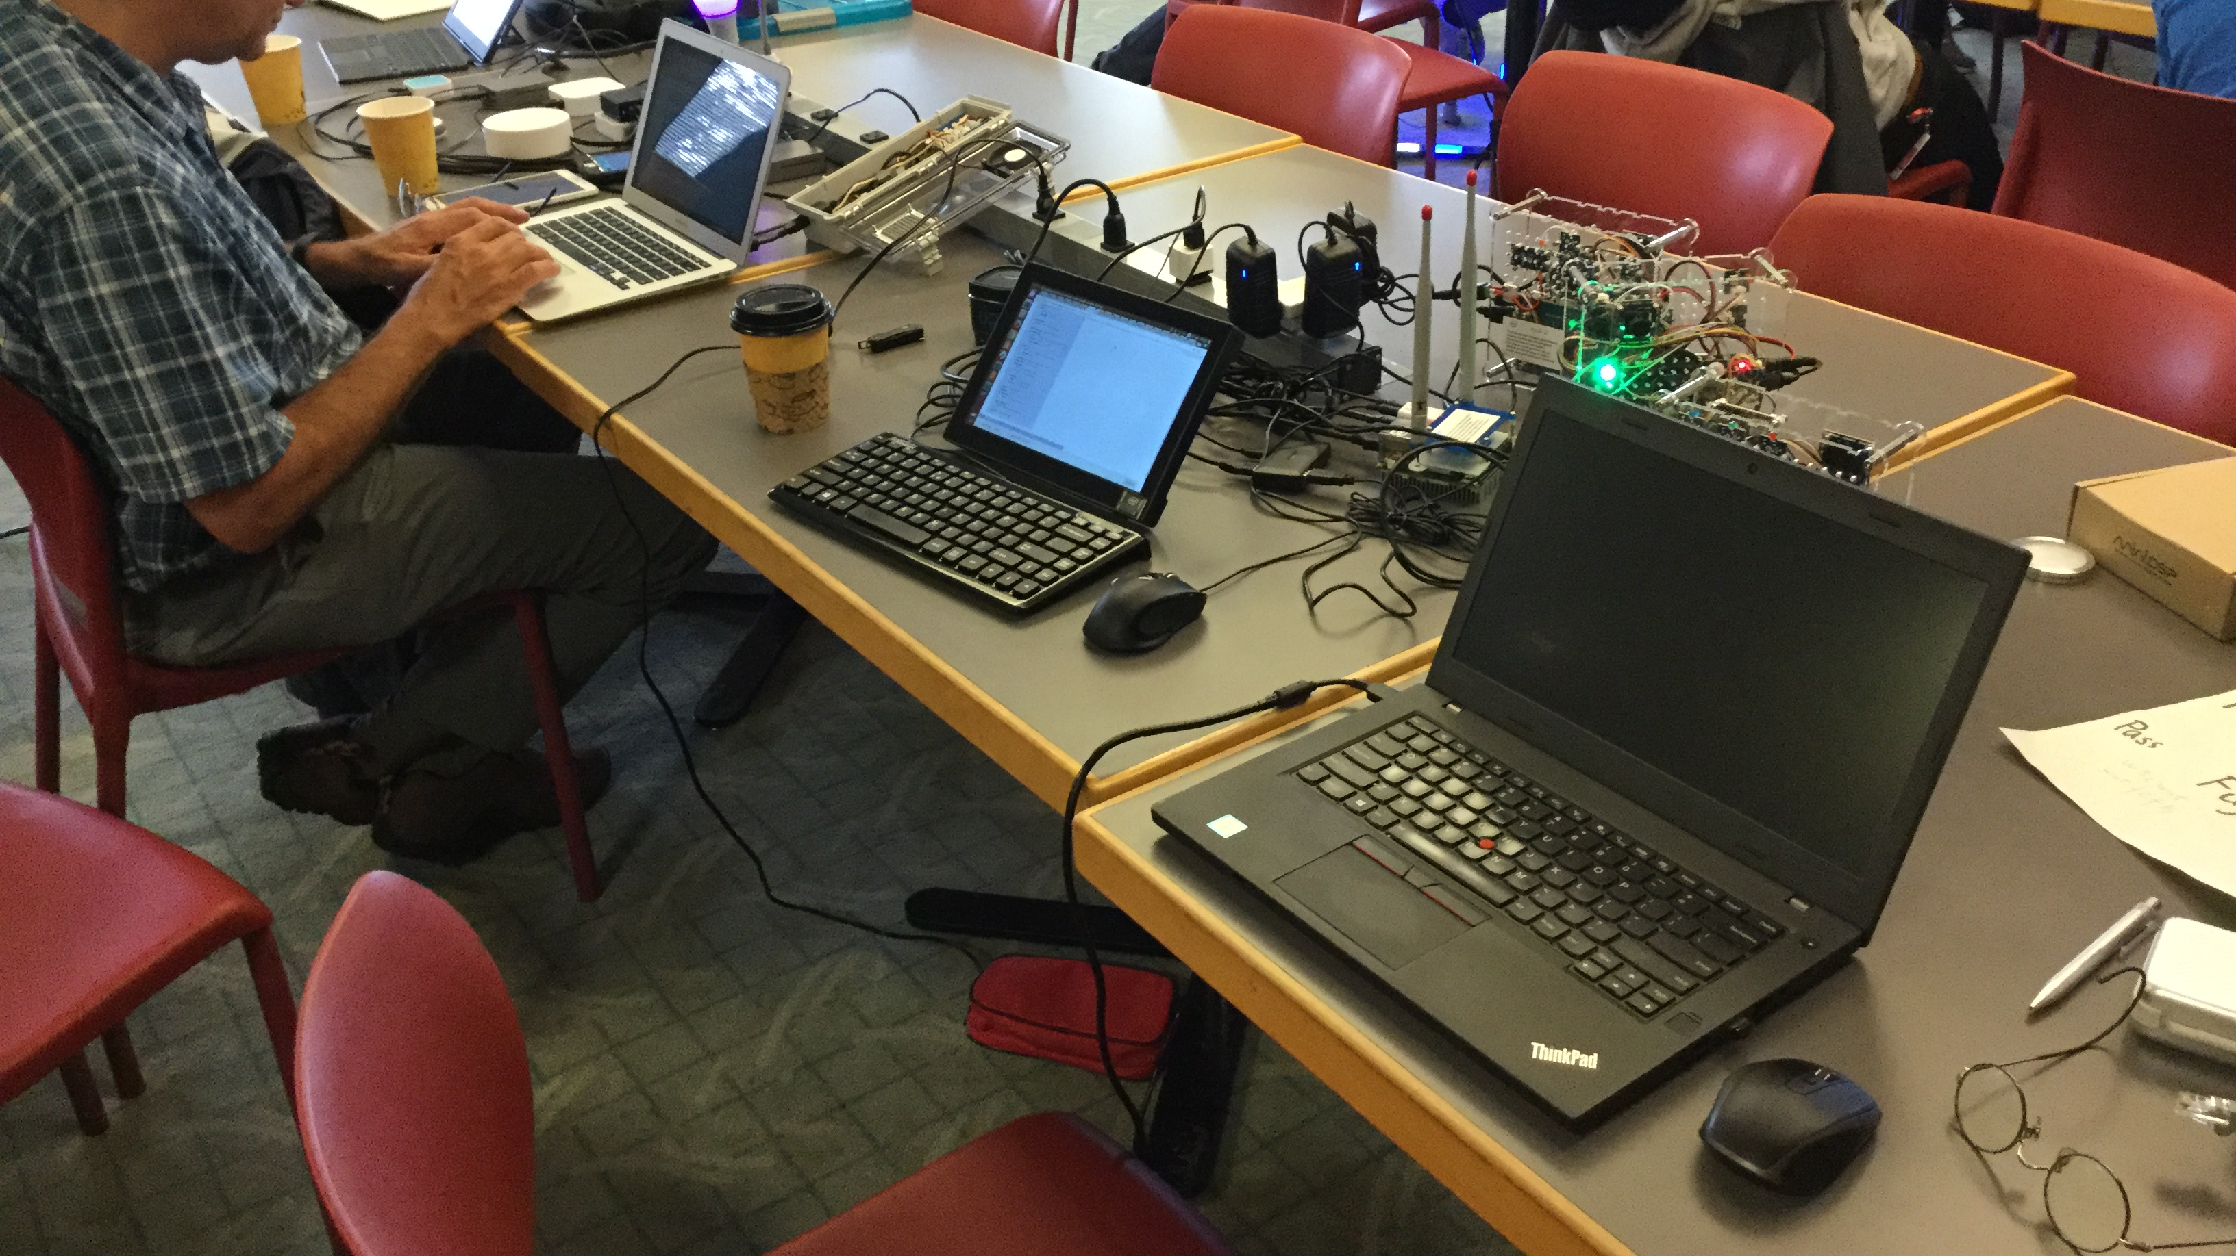

Slide 23
Metadata Bridge
WoT Thing Description …dynamically generated from OCF metadata
Metadata generator includes:
Semantic Annotation
WoT tdcontext, common context; iotschema.org,
HTTP methodName, rel
Capabilities (on Things), Interactions, Data
Protocol Bindings
inputData, outputData
{ "@context":["http://w3c.github.io/wot/w3c-wot-tdcontext.jsonld", "http://w3c.github.io/wot/w3c-wot-common-context.jsonld", {"iot":"http://iotschema.org/"}, // Prefix definitions for semantic terms {"http":"http://www.w3.org/2011/http/"}], "base":"http://example.ocfgateway.net/api/oic", "@type":["Thing","Light","iot:LightControl", // Capabilities "iot:Actuator","iot:BinarySwitch"], "name":"Intel-OCF-Smart Home LED (2relay)", "interaction":[ {"name":"Switch Status", "@type":["Property","OnOffState","iot:SwitchStatus"], // Interactions "link":[ {"href":"/a/led2relay?di=79683ab5-8df1-4b7a-b110-c1b8fe251e7d", "mediatype":"application/json", "http:methodName":"http:post", // Methods (specific to protocol binding) "rel":"setProperty"}, {"href":"/a/led2relay?di=79683ab5-8df1-4b7a-b110-c1b8fe251e7d", "mediatype":"application/json", "http:methodName":"http:get", "rel":"getProperty"} ], → Payload structure and semantics }, → Other interactions: Properties, Events, and Actions ] }

Slide 24
Metadata Bridge
// Payload structure and semantics for a Property interaction
"inputData":{ "type":"object", "fields":[ { "name":"value", "value":{ "@type":["iot:Toggle"], // Data "type":"boolean“ } } ] }, "outputData":{ "type":"object", "fields":[ { "name":"value", "value":{ "@type":["iot:Toggle"], "type":"boolean“ } } ] }
Metadata generator includes:
Semantic Annotation
WoT tdcontext, common context; iotschema.org,
HTTP methodName, rel
Capabilities (on Things), Interactions, Data
Protocol Bindings
inputData, outputData

Slide 25
Thing Directory: SPARQL Endpoint
Open-source thing-directory implementation at
https://github.com/thingweb/thingweb-directory
Proposal to include as Eclipse OSS project along with node-wot: https://projects.eclipse.org/proposals/eclipse-thingweb
Supports
Web service for dynamic creation, access, and deletion of Thing Descriptions
Search of various types supporting Thing discovery:
Text: simple text matching
Semantic: using SPARQL queries and inferencing using attached ontologies
The “Thing Directory service” is actually a SPARQL endpoint…
This means that searches can be federated with other SPARQL endpoints!

Slide 26
Issues: iotschema.org Limitations
Missing Terminology:
TemperatureSensor? IlluminanceSensor?
Inconsistent Terminology:
SwitchStatus/Toggle; Light Colour/Current Color; Temperature/TemperatureData; Light/TemperatureSensing
Most of these are due to lack of maturity/development
Not blocking issues…
Semantic tooling can bridge multiple ontologies
New and more precise ontologies can be used as they become available
… and as we learn how to write good ones and what the requirements are

Slide 27
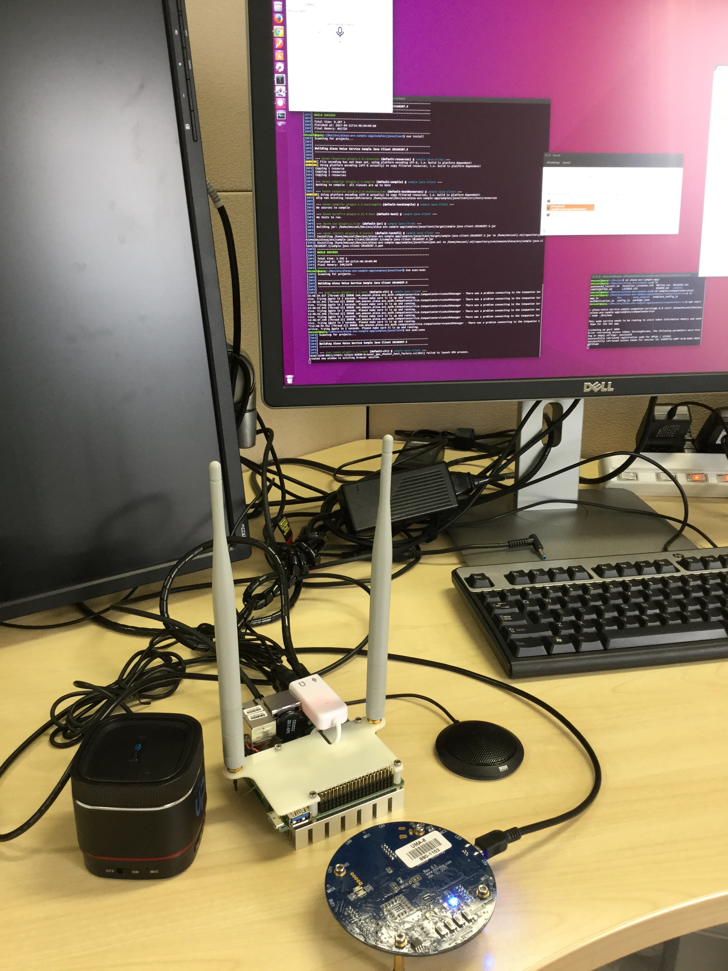
2. Semantic Voice Control
NOTE: Work in Progress (still…)
Goal: Enable automatic voice control of any WoT-enabled device
Demonstrate use of semantic markup of Thing Description
Using iot.schema.org, SSNO ontologies, and semantic inferencing tools
Generate adaptive AVS Alexa skill, bridging with Alexa Home Skill
Layer with WoT metadata bridges to control devices from multiple ecosystems (including OCF)
Notes:
AVS is picked as a concrete target, although the same approach could be used for Google Voice, Microsoft Cortana, etc.

Slide 28
2. Semantic Voice Control
Goal: Provide generic voice interface using WoT Thing Descriptions
Local Network
Cloud
NAT
Gateway
Local
Thing Directory
WoT/Alexa Home Skill Adapter
Thing Directory
OCF
Metadata Bridge
Relay (SSH Reverse Proxy)
HTTPS bridge
AVS Server
Voice Interface
Devices
AVS Client
OCF
Device
OCF
Device
Adapter queries Directory to find Things during Discovery
AVS Client invokes skill via Server and Adapter
Intents are mapped to appropriate semantic Actions
Far Field Microphone

Slide 29
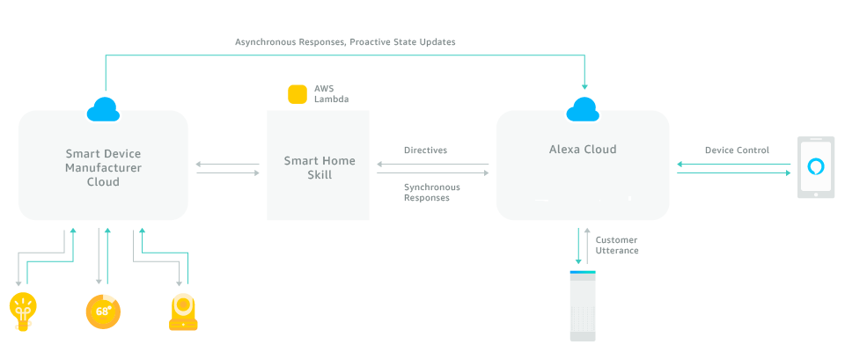
Alexa (AVS) Smart Home Skill: Service Architecture

Slide 30
AVS Home Skill Semantics: Capabilities
Device functionality is modeled by specifying a set of standard capabilities.
Each capability has a specific interaction model and payload …really more like an “interface” than just a semantic category
Devices can support more than one capability
“Device clouds” can have more than one device…
There are also a set of standard capabilities to get/set properties
Many capabilities support both absolute and relative mechanisms to adjust properties
Many “actions” also report the current state

Slide 31
AVS Home Skill Capabilities
Capability | Description
PowerController | TurnOn or TurnOff a device (has associated powerState)
PowerLevelController | SetPowerLevel (absolute) or AdjustPowerLevel (relative) on a device. Has an associated powerLevel property that can be set to a valuel between 0 and 100
PercentageController | Generic interface similar to PowerLevelController or BrightnessLevelController, but used when “power” or “brightness” is not a valid description of the controlled property. Assumes a value between 0 and 100 in an “percentage” property. Can also be used to read sensors.
TemperatureSensor | No controls, just use ReportState/StateReport to query “temperature” property.
BrightnessController | SetBrightness (absolute) or AdjustBrightness (relative) on a light. Has an associated brightness property that can be set to a value between 0 and 100
ColorTemperatureController | SetColorTemperature (absolute) or DecreaseColorTemperature, IncreaseColorTemperature (relative, no value) on a device. Has an associated colorTemperature property that can be set to a temperature in Kelvin (voice interface understands color names, “warm”, “daylight”, etc).
ColorController | SetColor of a light using “color” whose type is a hue, saturation, brightness (HSB) triple. Note that mapping from this to RGB involves a matrix transform and a nonlinearity. Voice interface uses color names.

Slide 32
AVS Home Skill Capabilities: Additional Examples
Capability | Description
LockController | Lock or Unlock a lock device
ThermostatController | Supports thermostats with one, two, or three setpoints. Can also be queried to find the current temperature using a property and ReportState/StateReport. There is also a “mode” property: ECO, AUTO, COOL, HEAT, etc.
InputController | Select AV input to a TV using set of standard names (HDMI, etc)
ChannelController | Select Channel on a TV (both absolute and relative)
PlaybackController | Start and stop audio source
SceneController | Select a scene by name. Some limits on discovery based on device type.
Speaker | SetVolume, AdjustVolume, SetMute
StepSpeaker | AdjustVolume, SetMute (a subset of “Speaker” with no absolute volume, for when range of volume is not known).
CameraStreamController | Start and stop streaming video

Slide 33
AVS Home Skill Semantics: System Messages
Directives can also create messages corresponding to “system capabilities”.
Capability | Description
Discovery | Every device: reports initial identification and capabilities
Authorization | AcceptGrant, provides bearer token, currently only OAuth2.0 supported
Response | Respond to directive - success
ErrorResponse | Respond to directive – error/failure, gives type of error, message for logging. Errors can include system issues (eg connectivity) but also payload issues (value out of range).
ReportState | Request state report
StateReport | Reply to state report
DeferredResponse | Used to indicate that will respond asynchronously to request (typ. >8s needed)
EndPointHealth | Check if physical endpoint can be reached from cloud shadow. Has associated Boolean property, “connectivity”

Slide 34
Summary
Interoperability has significant business value in IoT
Semantically-annotated WoT TD supports interoperability
Thing Directory supports semantic Thing discovery
Once Things found, Thing Description describes how to connect
WIP: Map AVS voice intents to semantic capabilities…
We need to work though some concrete scenarios (POCs)
Ideally, include fog computing in system architecture

Slide 35
WoT: Related W3C Standards
RDF: Resource Description Framework
General mechanisms for defining data semantics and vocabularies
Useful for working with metadata
SSNO: Semantic Sensor Network Ontology
Vocabularies (ontologies) and semantics for sensor data
JSON-LD: JSON (JavaScript Object Notation) Linked Data
Mechanism for encoding RDF in JSON, used for Thing Description serialization
See also:
iot.schema.org: Vocabularies and semantics for IoT, defined using RDF

Slide 36
Web of Things: Resources and Links
W3C: World Wide Web Consortium: https://www.w3.org
Web of Things Interest Group: https://www.w3.org/WoT/IG/
Charter: Leverage web standards and technology to enable IoT interoperation
Web architecture: https://www.w3.org/standards/webarch/
Web of Things Working Group in the W3C to develop standard recommendations:
https://www.w3.org/2016/09/wot-wg-charter.html
Co-chairs: Matthias Kovatsch (Siemens), Kazuo Kajimoto (Panasonic), Michael McCool (Intel)
White paper on WoT architecture: http://w3c.github.io/wot/charters/wot-white-paper-2016.html
WoT current practices: http://w3c.github.io/wot/current-practices/wot-practices.html

Slide 37
Ambient Standards Stack
Need to integrate complementary standards that promote interoperability
Management Services (ex: OpenFog)
Defines platform for federated edge and cloud services
Common services for discovery, security, monetization, updates, etc.
Metadata Standards (ex: WoT, iotschema.org, Haystack, etc.)
Enable cross-ecosystem service discovery and composition
Supports semantic interoperability which enhances usability
Device Standards (ex: OCF, MQTT, LwM2M, AWS IoT, etc.)
Define standard local interfaces for devices and services
Notes:
WoT is the glue that pulls things together
Orchestration wrong word; more federation, management, governance, lassoing, self-organizing
Third bullet: federated services

